Slide 1
High-Performance Querying on RAW data
Anastasia Ailamaki
EPFL

Slide 2
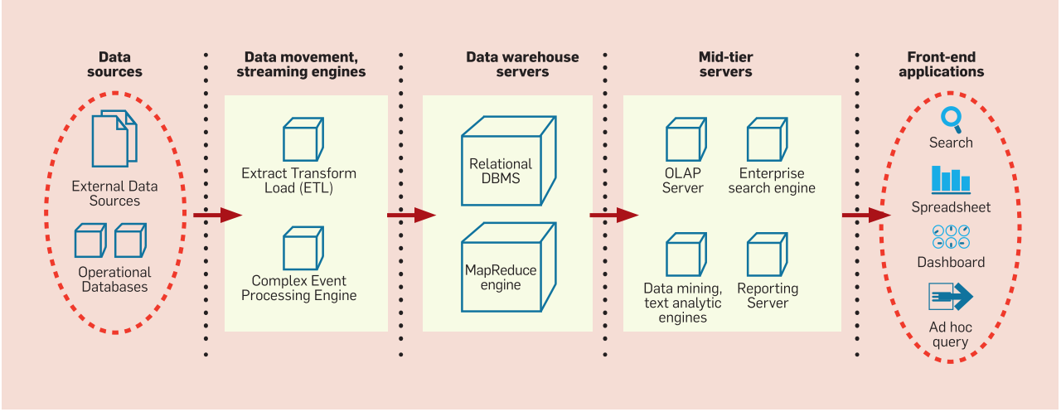
create a database to run queries
RAW DATA FILES
LOAD INTO DB
REPORT RESULTS
QUERY
APPLICATIONS
data-to-query time too long
data “locked” in vendor
private data: no move, no copy
Source: “An Overview of Business Intelligence Technology”.
S. Chaudhuri, U. Dayal, V. Narasayya. CACM August 2011

Slide 3
run queries to create a database
MapReduce Engine
Relational DBMS
Data Virtualization and Harmonization
…
Enterprise Search Engine
…
External Data
Sources
Operational
Databases
…
Reporting Server
Spreadsheet
invest only in interesting data

Slide 4
easy for you to say
No ETL
Declarative querying is king
Complex data: tables; arrays; hierarchies
large-scale vertical integration
Flexibility: multiple file formats; no static schemas; …
Efficiency!

Slide 5
Higgs analysis with RAW
SELECT event.jet…
FROM goodruns.CSV, atlas001.root
WHERE csv.RunNumber == root.RunNumber AND
root.EF_2mu13 == TRUE AND …
join
scan
csv
filter
scan
root
Code Generate the Access Paths
Code Generate the Query
Build Position and Data Caches
ROOT
CSV
… containing
“good” run numbers
RAW is 100x faster
… containing
physics events

