Slide 1
The Three E’s of Big Data and What DB People can do About Them
Michael Franklin – UC Berkeley
Beckman Database Get Together
October 14, 2013
UC BERKELEY

Slide 2
The Big Data Problem - Nutshelled
Something’s
gotta
give:
Time
Quality
Money
Massive Diverse and Growing
Data

Slide 3
The 3 E’s of Big Data:
Extreme Elasticity Everywhere

Slide 4
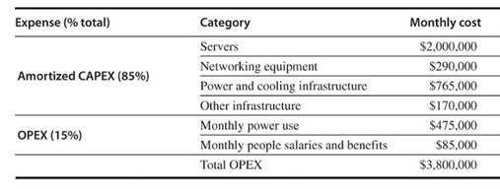
Extreme Elasticity - Machines
Option #1 – Build your own Cluster/WSC
Option #2 – Rent Machines from AWS
46K Servers
(2010 estimate)
Option #3 – Try your luck on the Spot Market
x Servers needed
x Servers needed
(US East – Saturday Sept 28 @1:30am)
Notes:
720 hours per month per machine so AWS cheaper if 5277 machines or less
Spot is about the same price!

Slide 5
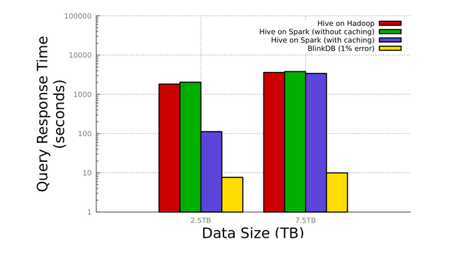
Extreme Elasticity - Algorithms
Agarwal et al., BlinkDB: Queries with Bounded Errors and Bounded Response Times on Very Large Data. ACM EuroSys 2013.

Slide 6
Extreme Elasticity - People
Incentives
Fatigue, Fraud, & other Failure Modes
Latency & Prediction
Work Conditions
Interface <-> Answer Quality
Task Structuring
Task Routing

Slide 7
Extreme Elasticity
Algorithms
Approximate Answers
Machines
Cloud Computing – esp. Spot Instances
Multi-tenancy
People
Dynamic Task and Microtask Marketplaces
Visual analytics
ML Libraries and Ensemble Methods
Relaxed (eventual) consistency/ Multi-version methods
Active Learning
Manipulative interfaces and mixed mode operation

Slide 8
The Challenge
Extreme Elasticity
+ Tradeoffs
+ AMP Integration
= Extreme Complexity

Slide 9
The Good News: We already know how to do this (kinda)!
End Users tell the system what they want, not how to get it
SQL
Result
MQL
Model

Slide 10
MLbase: Progress
initial
release:
Spring
2014
MQL Parser
Query Planner / Optimizer
ML Library
(Contracts)
ML Developer API
Runtime
Released
July 2013

Slide 11
For More Information
UC BERKELEY
amplab.cs.berkeley.edu
franklin@berkeley.edu

