Slide 1
Quo Vadis?

Slide 2
What is Our Core?
Systems
Algorithms/ Theory
DB
PL
Notes:
We are missing the boat over and over again
MR/Hadoop (systems, PL, machine learning)
Graphs (systems, ML)
Sensor networks → TinyOS

Slide 3
What Is Our Core?
There are so many interesting new concepts in other communities
PL: Synthesizing (concurrent) data structures
Algorithms: Cache-oblivious algorithms, models of social behavior
Systems: Time APIs, mini-transactions, has become applied side of PL
ML: Deep learning
What should we teach other students these days?
We don’t want them to be shallow in any way
But we also cannot teach them everything
Are the community that builds relational databases? What are our concepts?
Notes:
We do not have a one-liner “north star” anymore:
Build a computer that can think
Build a robot that can assist an older person in all aspects of their life
Build systems that never fail

Slide 4
What is Our Core?
Systems
Algorithms/ Theory
DB
PL
Notes:
We are missing the boat over and over again
MR/Hadoop (systems, PL, machine learning)
Graphs (systems, ML)
Sensor networks → TinyOS

Slide 5
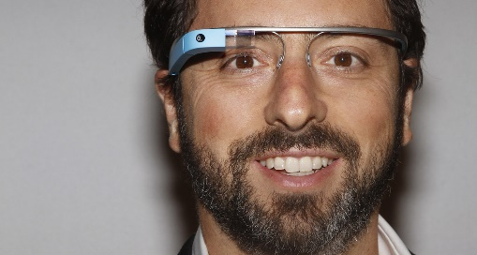
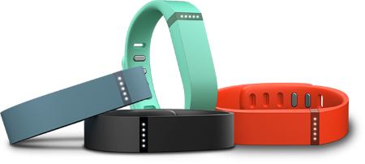
Research Directions
New devices
Images, videos
Programmer productivity
Monitoring

Slide 6
Community Action
Create shared infrastructure (a cloud, a set of tools with documentation, that we use in our courses so that students will know it?)
Create new benchmarks

