Slide 1
Complexity must be conquered (Data is more than “just” big)
Laura Haas
IBM Almaden Research Center

Slide 2
Data is everywhere…
The 4 V’s of Data
Volume
Velocity
Variety
Veracity
40 zettabytes in 2020*!
Data at Rest
Data in Motion
Data in Many Forms
Explosive growth of data
From devices, systems, individuals
Huge demonstrated and anticipated value from leveraging data
Data in Doubt
But discovering insight is rare!
Complexity is high: 4V’s have broad implications
Requires broad expertise in systems, data management, analytics/mathematics, AND the domain
Sometimes hard to even know where to start!
Costs in dollars and time are high
Detect life-threatening conditions at hospitals in time to intervene
Multi-channel customer sentiment and experience analysis
Discover and optimize new treatments by mining data from patents and literature
* IDC
Notes:
IDC estimate, 2012

Slide 3
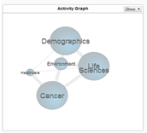
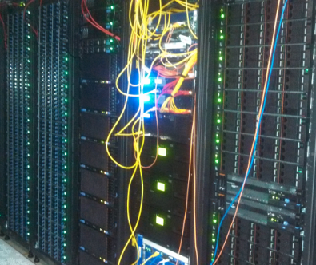
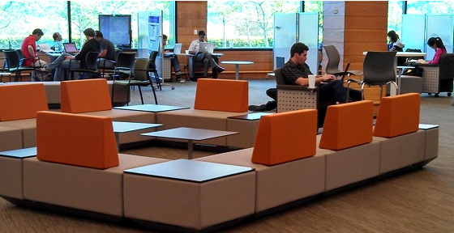
The Accelerated Discovery Lab
Scaling Human Capabilities for Foresight through Collaborative Innovation
What is the Accelerated Discovery Lab?
A shared resource for Research, IBM and clients
A complete environment for data analytics
Hardware, software, and physical space
Help users get insight from more data, more data sets, more experts – fast
Support analytics across and within industries
Benefit from shared learning and serendipity
Reduce costs and risk, get faster time to value!
Industry-specific Investigations
Serendipitous User Experience
Analytics & Workbenches
Expertise
Hardware & Software Infrastructure
Data Sets
How are we accelerating discovery?
Give users everything they need for data wrangling and analytics
Rich collection of analytics and tools
Powerful infrastructure for data management and analytics
Pre-integrated data sets to provide context
Provide expertise and guidance in all phases of the process
Human expertise
Collaborative, exploratory user experience

Slide 4
This requires a broad research agenda
Improving the infrastructure, middleware, tools and algorithms for discovery
Acquisition of data, entity understanding and alignment, metadata capture, …
New mining algorithms, machine learning, model composition, development tools, …
New architectures for scaling, performance, privacy, …
Creating an intelligent, collaborative environment to accelerate discovery
User experience: virtual and physical workspaces
Middleware to support discovery: knowledge management, reasoning, recommendations,…
Leveraging data to solve domain-specific challenges
Understanding fundamentals of disease, cohort formation, drug prediction, …
Optimizing management of heavy equipment, predicting and managing disasters, …
Improving client service, increasing revenues, reducing risk, …
And many more for these and other industries!

Slide 5
