Slide 1
Crowd Mining
Tova Milo

Slide 2
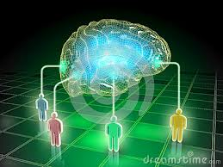
The research frontier
Think of humanity and its collective mind expanding…
But first a story…
Crowd Mining

Slide 3
Let us put this in research terminology…
Imprecise, under-specified questions.
Often in natural language.
Search for common/interesting/useful/exceptional patterns in an “open world”
Huge amounts of relevant data sources & content.
Often in natural language.
Partially only in people minds!
Many important application domains:
(Folk) medicine, Social studies, Education, Cyber security, Scientific experiments,…
Requires a new type of crowd-assisted (interactive) mining
Crowd Mining

Slide 4
Mining with the crowd
Mining for what?
Query understanding and refinement
Identifying relevant information sources
Relevant patterns and answers
How?
Mining human and computerized knowledge
Interactive incremental process
Crowd mining is very different from traditional data mining!
The questions/answers that one can ask/get
Availability, behavior, error, reliability, cost…
User capacity of grasping information
Need to develop new toolkits
NLP, ML, statistics, phycology, HCI, …
Hey ,but isn’t this again all about source capabilities???!!!
Yes, but very different… Huge number of sources, very interactive, very diverse
Crowd Mining

Slide 5
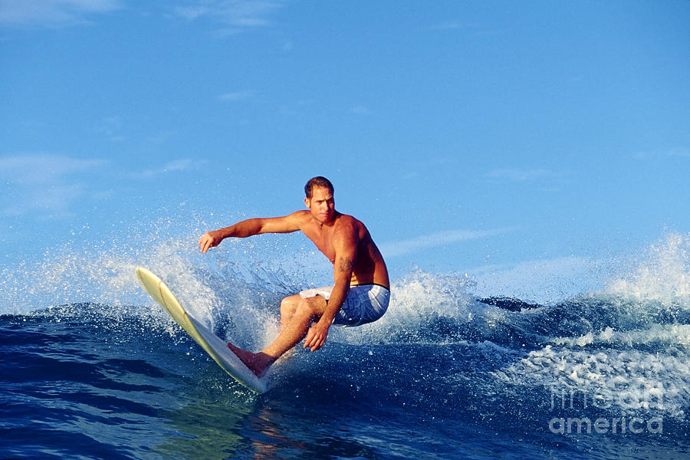
The end of the story…
My son passed the exam (smart kid :-)
But decided that he prefers to have fun for three months rather than spend his days programming… (even smarter :-)
Crowd Mining

