Slide 1
Internet of Things, Here an App There a Map … And What It All Means: DB or Not DB
Raghu Ramakrishnan
Cloud Information Services Lab (CISL)
Microsoft

Slide 2
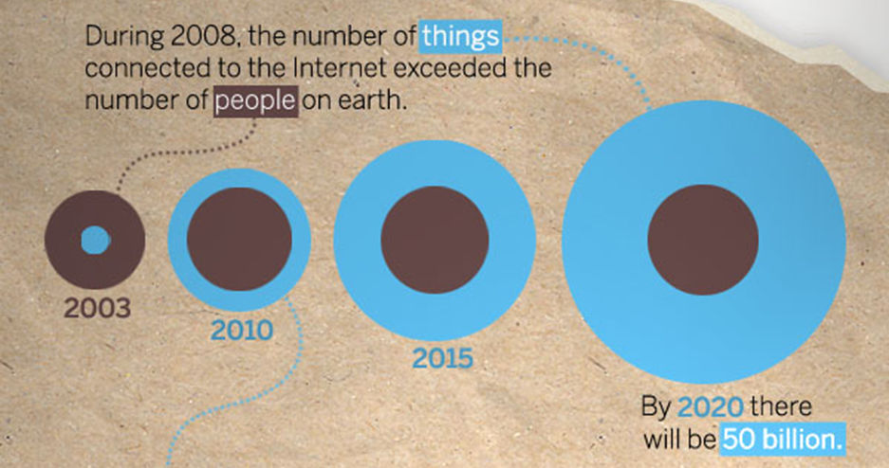
IoT: Connected Devices, Continuous Observations, Instantaneous Action, Rich History
http://blogs.cisco.com/news/the-internet-of-things-infographic/
Gartner: 50 billion intelligent devices by 2015 and 275 Exabytes per day of data being sent across the Internet by 2020
Notes:
2008: more things than people
2020: 50 billion

Slide 3
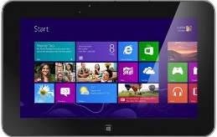
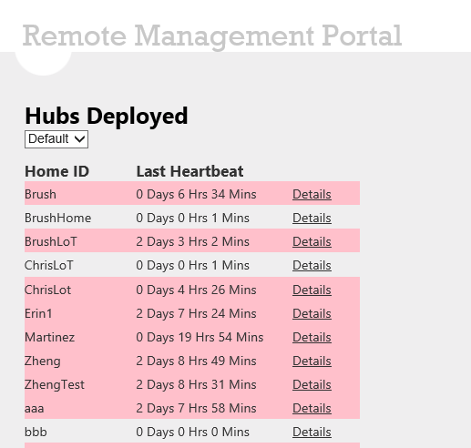
HomeOS: An Instance of IoT
Analysis scripts
Data logger
Monitor
Updater
Relayer
App UI
Apps
Scouts
HomeOS
Drivers
(Slide courtesy Ratul Mahajan, MSR)

Slide 4
SQL / Hive /MR
Stream Processing
Business
Intelligence
Machine
Learning
THE DIGITAL SHOEBOX
Capture any data, react instantaneously, mix with data stored anywhere
Tiered storage management
Federated access
Use any analysis tool (anywhere, mix and match, interactively)
Compute fabric
Collaborate/Share selectively
Compute Fabric
DATA INGEST
Shoebox Store
Tiered Shoebox Store
Remote
Stores

Slide 5
DB or Not DB
That’s the question …
Whether it’s truer to the spirit
To study the springs and furrows of outrageous platforms
Or to take cloud farms against a sea of observations
And by deep learning, act on them
SIGMOD
Too broad?
NIPS
Where’s the database?

