Slide 1
Explaining The Data Dan Suciu
Or: is there anything left to do except helping out the 3 big DB vendors, or improving google’s click-through rate?

Slide 2
Where Do The Data Analysts Spend Most of Her Time?
In query processing?
Query optimization?
Waiting for the L2 cache misses?
Cleaning and uploading the data?
In line at Starbucks?
Answer: none of the above. She spend her time trying to understand and explain the results of her data analysis

Slide 3
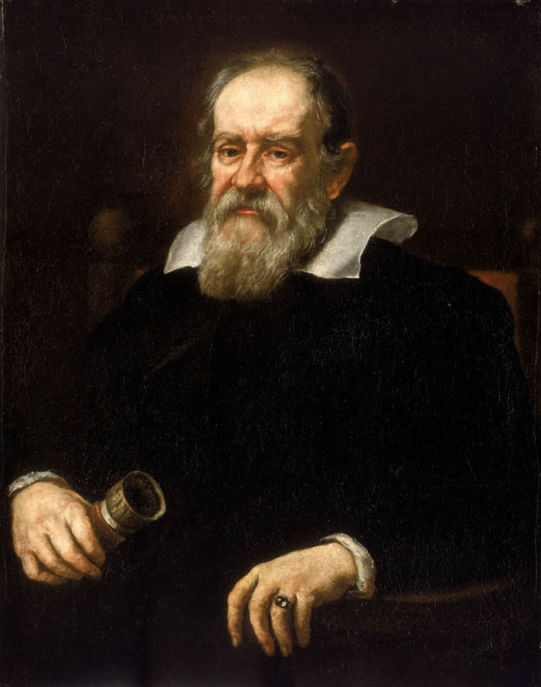
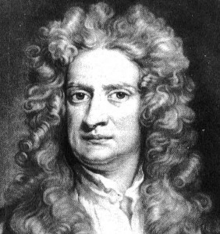
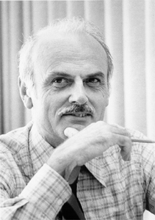
Explaining is Hard
Science does not teach us how to find causes. We learned it anyway
F = m a
Check one:
Does acceleration cause the force?
Does the force cause the acceleration?
Does the force cause the mass?
Databases do not help us find explanations And we are clueless
create table Orders (
… partid int references Part…)
Check one to explain:
Supp2 produced too few parts in 2009
Database is missing Q2, Q3, Q4 for 2009
Supp2 had bad reviews on Yelp
Elvis Presley is alive
Notes:
The second Law of Motion tells us how Force, Acceleration, and Mass are related. It DOES NOT tell us which causes what. Now, of course, we know that the force causes the acceleration and not vice versa, and none causes the mass.
Take a database. A constraint is like a Law. Every order reference to exactly one part, and that part must exists. We know that it must hold. But can we turn this into some form of reasoning about causality? We look at a graph showing the total number of orders per supplier, per year, and we see an outlier. We don’t know how to use the constraint to EXPLAIN the dip. Maybe Supp2 produced too few parts in 2009, which we can figure out by examining a different table, about total production. Maybe there is missing data from Q2-Q4, which explains why the total is so low. Maybe there is a statistical correlation with bad reviews on Yelp, which requires some sentiment analysis and record linkage.

Slide 4
The Emerging Science Of Causality and Explanation
AI
Judea Pearl’s influential work on causality
Foundational work by Halpern, Pearl and others
Work on explanation
Databases
Provenance
Causality of query answers
Automated data analysis in OLAP cubes
Explanations: PerfXplain, Scorpion
We all agree on what is causality is, but it’s not derivable from data. We can find explanation in data, but there’s no agreement what it is.
Notes:
Algorithmic and computational aspects of causality have been investigated only recently, by Pearl and his collaborators. Causality has a very high bar, because the only way to establish causality is through a controlled experiment: you repeat the same experiment twice, changing only one variable, and if the output changes, then you have causality. We can’t do this by analyzing data only. Pearl circumvents that by assuming that causal paths exists, allowing for an algorithmic definition of causality. For example, in databases causal paths for query answers can be derived from query provenance. Explanation lowers the bar and attempts to prove only that, as far as the system can infer from the data, if you change this input then it will affect the output in the direction you expect. Some attempts exists in the database literature to develop systems that “explain”, but there is no universally aggreed definition of what an “explanation” means.

Slide 5
A Ten Years Research Agenda
Challenge 1: explanation as an interactive process
Help users sort out likely/plausible/unlikely explanations
Help users ask the next query
Think “Potter’s Wheel”, not “Watson”
Challenge 2: understanding causal paths
Provenance
Constraints (foreign keys and much more)
Data mining
Challenge 3: visualizing explanations
Notes:
So here are my 2 cents for a long term research agenda. Study explanation in Big Data. One challenge is to define explanation as interactive process. The goal is not to return the ultimate cause (which is probably impossible), but to return some interesting facts that entice the user to ask more queries, eventually finding the explanation they seek. The second task is to define and compute the causal paths. Provenance, foreign keys, and associations discovered through data mining are candidates for causal paths, and there are likely more. Computing these is challenging: if causal paths are edges in a graph, then we are talking a recursive query. Actually, many recursive queries: one for each candidate explanation. Finally, the last grant challenge is to visualize explanations. The system should somehow determine automatically how to show the best graph that illustrates the explanation.

